Slide 1
Numerical integration
Chapter 3, “An introduction to computational physics”,
Tao Pang, 2nd ed., Cambridge Univ. Press

Slide 2
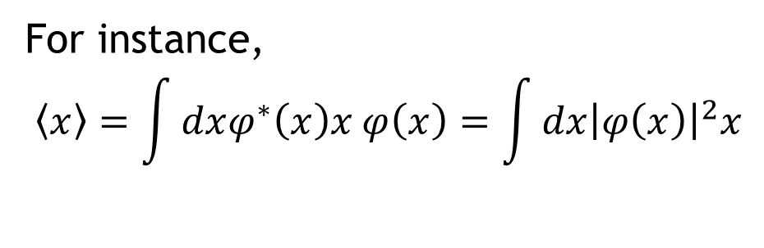
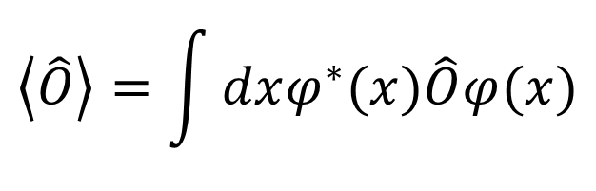
Physical example: mean values of observables
$$\left\langle \hat{O}\right\rangle =\int{dxφ^{∗}(x)\hat{O}φ(x)}$$
For instance,
$$\left\langle x\right\rangle =\int{dxφ^{∗}\left(x\right)x φ\left(x\right)=\int{dx{\left|φ\left(x\right)\right|}^{2}x}}$$

Slide 3
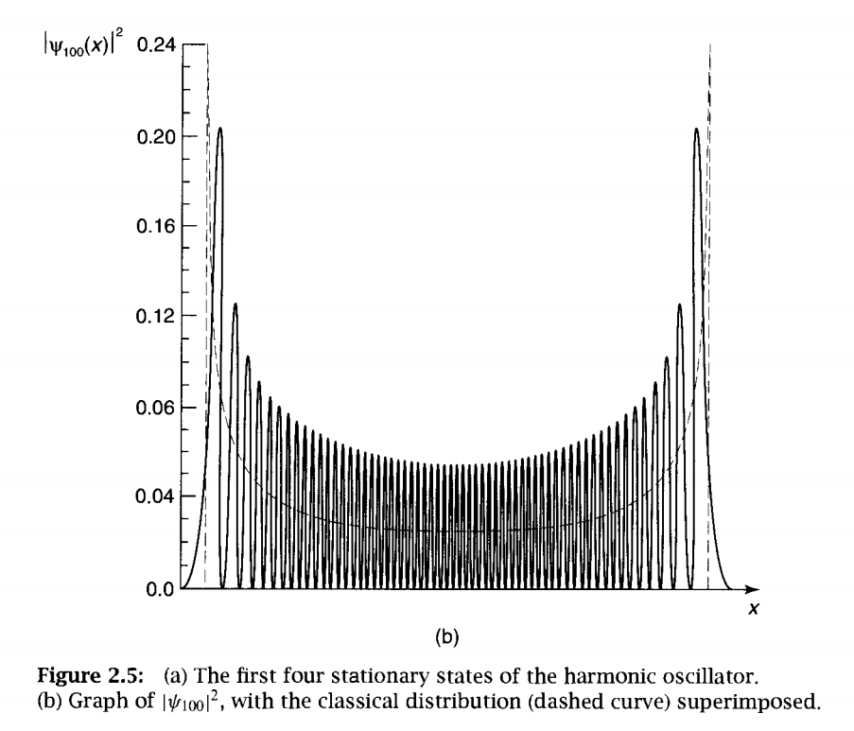

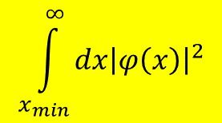

Physical example: probability of finding a particle in a space domain
$$x_{max}$$
$$\int_{x_{min}}^{∞}{dx{\left|φ\left(x\right)\right|}^{2}}$$

Slide 4

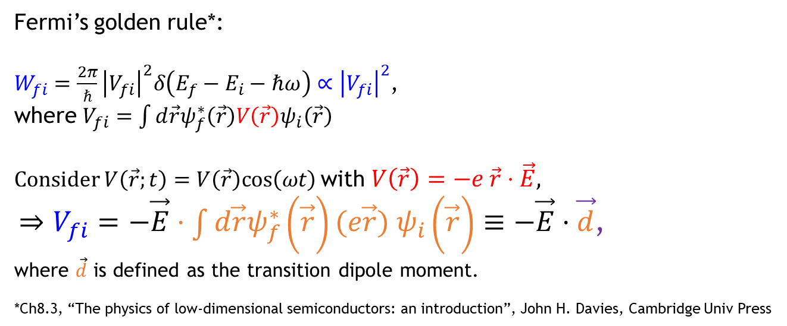

Physical example: Optical transitions
Ch.9 (9.29) “Quantum Optics: An introduction”, M. Fox.: p176 Example 9.1 (FGR); p178 Example 9.2
Fermi’s golden rule*:
$W_{fi}=\frac{2π}{ℏ}{\left|V_{fi}\right|}^{2}δ\left(E_{f}−E_{i}−ℏω\right)∝{\left|V_{fi}\right|}^{2}$,
where $V_{fi}=\int{d\vec{r}ψ_{f}^{∗}\left(\vec{r}\right)V\left(\vec{r}\right)ψ_{i}\left(\vec{r}\right)}$
Consider $V\left(\vec{r};t\right)=V\left(\vec{r}\right)cos\left(ωt\right)$with $V\left(\vec{r}\right)=−e \vec{r}⋅\vec{E},$
$⇒V_{fi}=−\vec{E}⋅\int{d\vec{r}ψ_{f}^{∗}\left(\vec{r}\right)(e\vec{r}{) ψ}_{i}\left(\vec{r}\right)}≡−\vec{E}⋅\vec{d}$,
where $\vec{d}$ is defined as the transition dipole moment.
*Ch8.3, “The physics of low-dimensional semiconductors: an introduction”, John H. Davies, Cambridge Univ Press
$$ψ_{f}$$
$$ψ_{i}$$

Slide 5
Numerical integration
x₀=a
x_{i}
x_{i+1}
x_{n}=b

Slide 6
Recall: Taylor series…

Slide 7
Rectangular rule
h
x_{i}
x_{i+1}

Slide 8

trapezoid rule
$$h≡x_{i+1}−x_{i}$$
x_{i}
x_{i+1}

Slide 9
Exercise: numerical integration
exercise
C:\Users\sjche\Desktop\Work place\teaching\computational physics\numerical calculus\1d integration.py

Slide 10
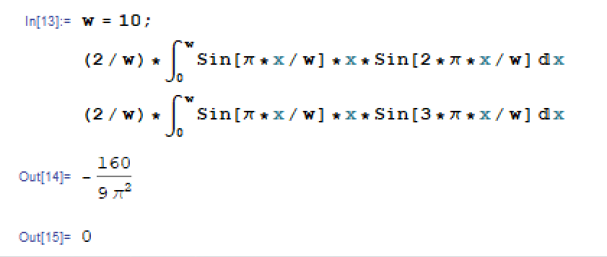



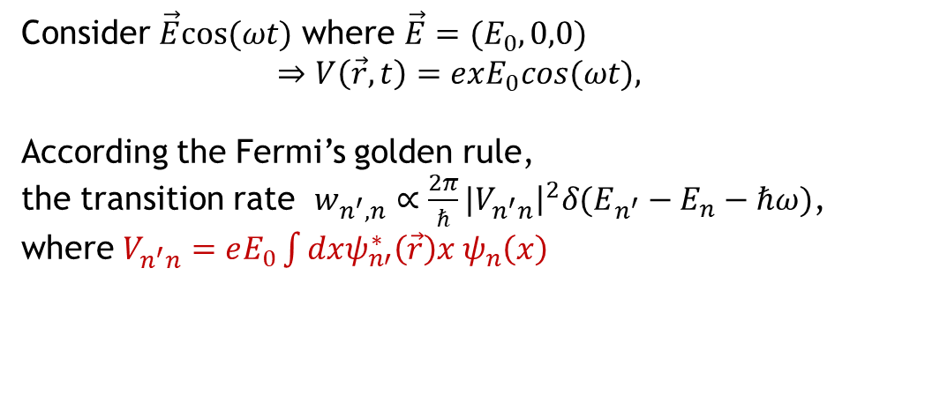



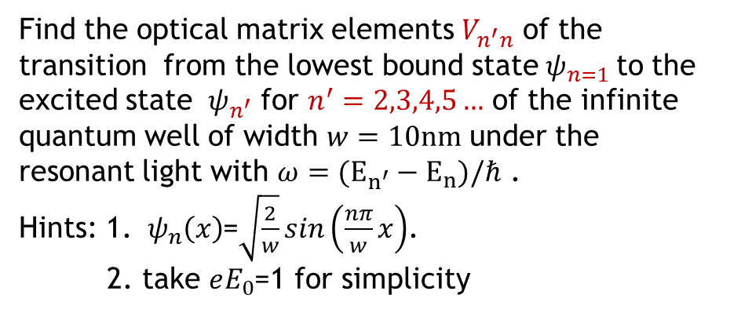
Selection rule of optical transitions in an infinite potential well
HW 4.1: deadline 04/19
Consider $\vec{E}cos⁡(ωt)$ where $\vec{E}=(E_{0},0,0)$
$$⇒V\left(\vec{r},t\right)=exE_{0}cos⁡(ωt),$$
According the Fermi’s golden rule,
the transition rate ${w_{n^{′},n}∝\frac{2π}{ℏ}|V}_{n^{′}n}{\left.​\right|}^{2}δ(E_{n^{′}}−E_{n}−ℏω)$,
where $V_{n^{′}n}=eE_{0}\int{dxψ_{n′}^{∗}\left(\vec{r}\right)x{ ψ}_{n}\left(x\right)}$
$$n=3$$
X
$$n=2$$
Find the optical matrix elements $V_{n^{′}n}$ of the transition from the lowest bound state${ ψ}_{n=1}$to the excited state ${ ψ}_{n^{′}}$ for $n^{′}=2,3,4,5…$ of the infinite quantum well of width $w=10nm$ under the resonant light with $ω=(E_{n^{′}}−E_{n})/ℏ$ .
Hints: 1. ${ ψ}_{n}\left(x\right)$=$\sqrt{\frac{2}{w}}sin\left(\frac{nπ}{w}x\right)$.
2. take $eE_{0}$=1 for simplicity
$$n=1$$
O
$$x$$
$$x=0$$
$$x=w$$

Slide 11
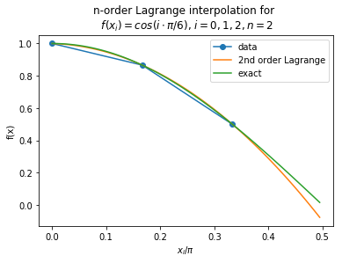



Simpson rule: using the Lagrange interpolation
$$x_{0}=0$$
$$x_{1}=π/6$$
$$x_{2}=2⋅π/6$$
C:\Users\sjche\Desktop\Work place\teaching\computational physics\numerical calculus\lagrange-interpol-2nd-order.py

Slide 12
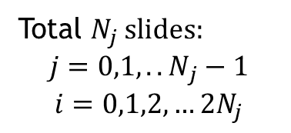
Simpson rule (…continued)
i=2j+1
i=2j
i=2j+2
Total $N_{j}$ slides:
$${j=0,1,..N}_{j}−1$$
$$i=0,1,2,…2N_{j}$$
i=2j+2=2N_{j}
j=N_{j}-1
i=j=0
a
x_{2j}
x_{2j+1}
x_{2j+2}
b
Remark: The third order term vanishes because of cancellation.
We have to have even number of slides in the use of the rule.

Slide 13





Simpson rule: proof
$$t⋅h$$
$$x$$
●
$$x_{i−1}$$
h
$$x_{i}$$
h
$$x_{i+1}$$

Slide 14
Exercise: numerical integration
exercise
C:\Users\sjche\Desktop\Work place\teaching\computational physics\numerical calculus\1d integration-simpson.py

Slide 15
Approximation of a function
Lagrange interpolation
Cublic spline
Ref: Ch.3 “Numerical methods in engineering with Python3”, Jaan Kiusalaas

Slide 16
Taylor expansion

Slide 17
Linear interpolation
h

Slide 18
The Lagrange interpolation (n=1)

Slide 19
The Lagrange interpolation (n=1)

Slide 20
The Lagrange interpolation (n=2)
C:\Users\sjche\Desktop\Work place\teaching\computational physics\numerical calculus\lagrange-interpol-2nd-order.py

Slide 21
The nth-order Lagrange interpolation
C:\Users\sjche\Desktop\Work place\teaching\computational physics\numerical calculus\lagrange-interpol.py

Slide 22
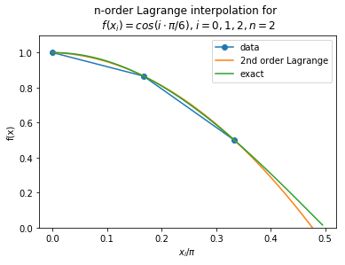
Exercise: 2nd-order Lagrange interpolation
exercise
use the 2nd-order Lagrange formula to interpolate the set of data $\{f_{i}=cos\left(x_{i}=i\frac{π}{6}\right)\}$ for $i=0,1,2$
and compare the interpolated curve with the exact values of $\cos{x}.$
C:\Users\sjche\Desktop\Work place\teaching\computational physics\numerical calculus\lagrange-interpol-2nd-order.py

Slide 23
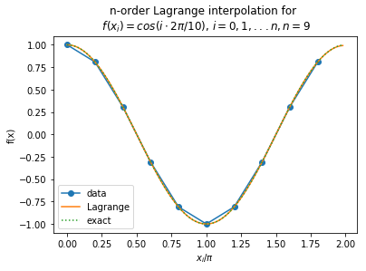
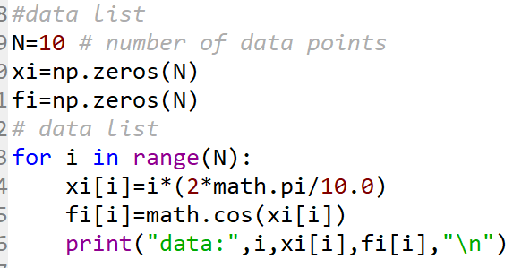
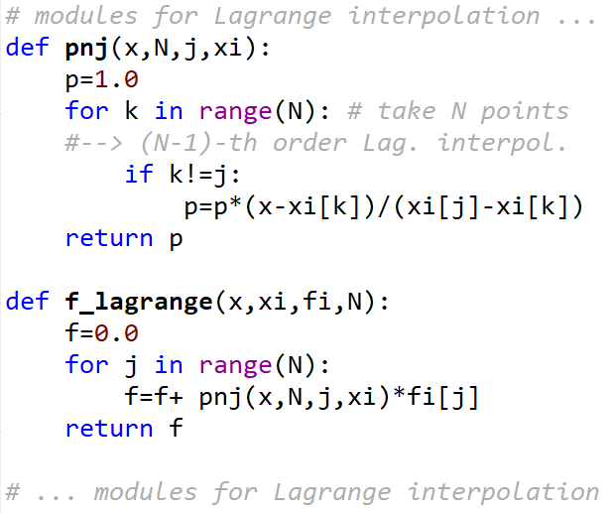
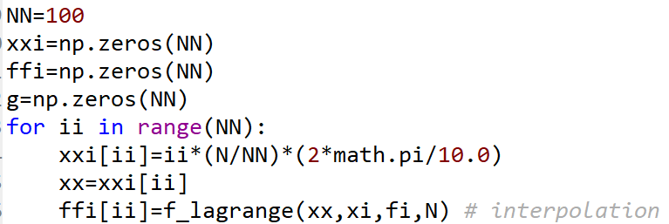
Homework: 2nd-order Lagrange interpolation
Homework: deadline 05/18
use the 2nd-order Lagrange formula to interpolate the set of data $\{f_{i}=cos\left(x_{i}=i\frac{π}{10}\right)\}$ for $i=0,1,2$,…9
and compare the interpolated curve with the exact values of $\cos{x}.$
C:\Users\sjche\Desktop\Work place\teaching\computational physics\numerical calculus\lagrange-interpol-2nd-order.py

Slide 24
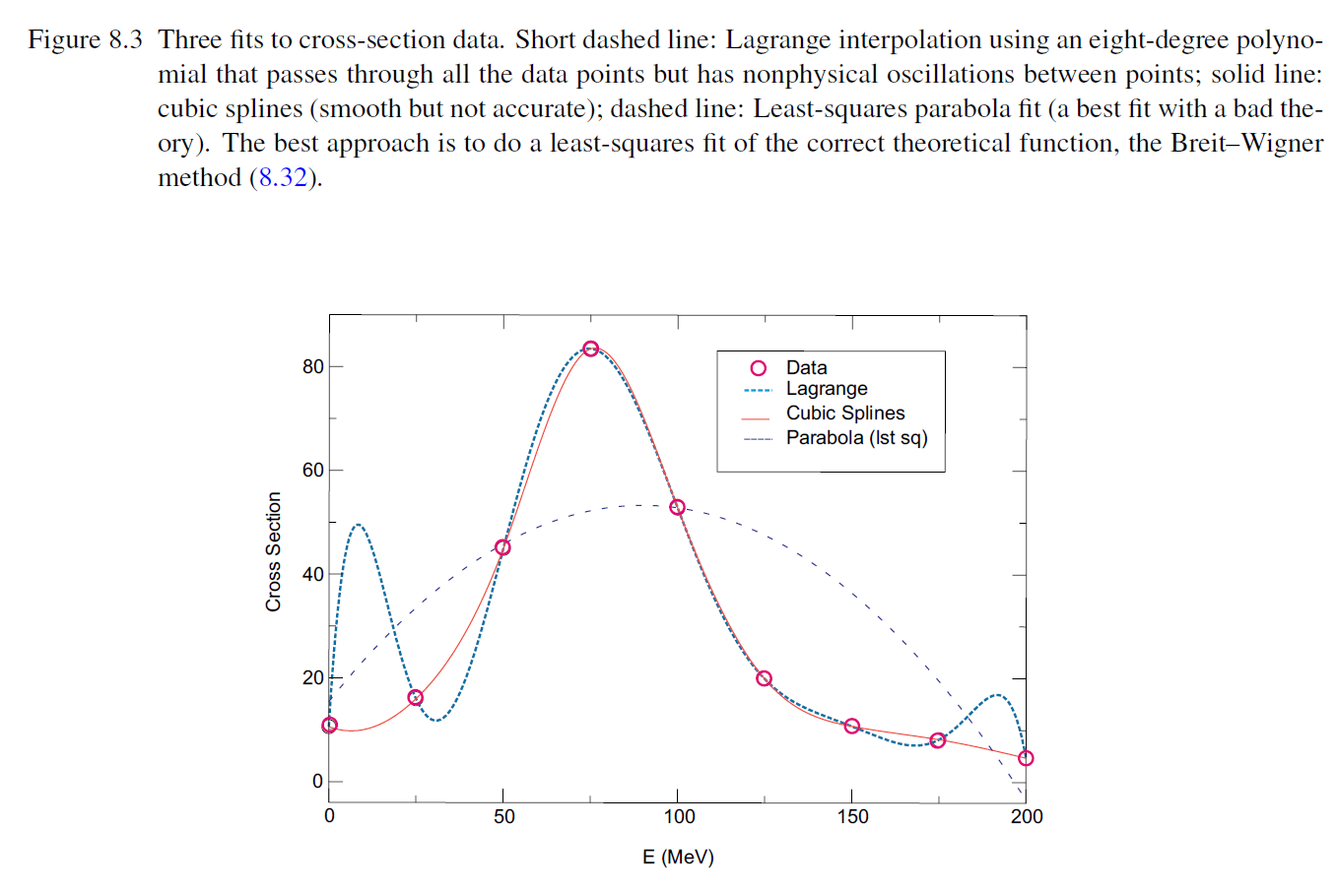
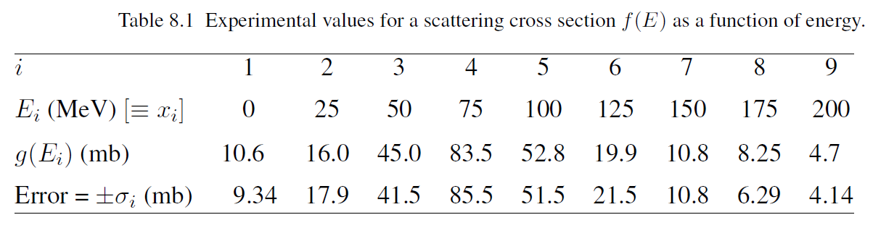
Homework: Lagrange interpolation
Homework: deadline 05/18
Interpolate the measured spectrum of a scattering cross section from the following nine experimental data
by using the method of Lagrange interpolation.

Slide 25
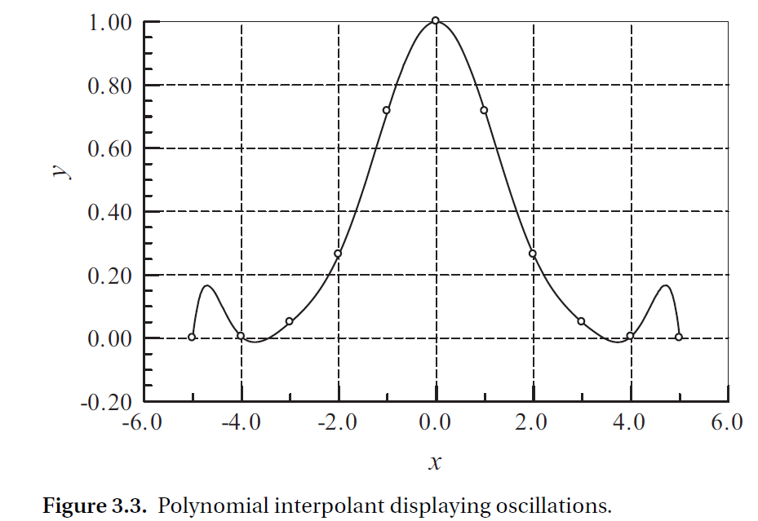
Limitations of Polynomial interpolation
Ref: Ch.3 “Numerical methods in engineering with Python3”, Jaan Kiusalaas
Limitations of Polynomial Interpolation
Polynomial interpolation should be carried out with the fewest feasible number of data points. An interpolant intersecting more than six points must be viewed with suspicion (!!). The reason is that the data points that are far from the point of interest do not contribute to the accuracy of the interpolant. In fact, they can be detrimental.
The danger of using too many points is illustrated in Figure 3.3. The 11 equally spaced data points are represented by the circles. The solid line is the interpolant, a polynomial of degree 10, that intersects all the points. As seen in the figure, a polynomial of such a high degree has a tendency to oscillate excessively between the data points.

Slide 26
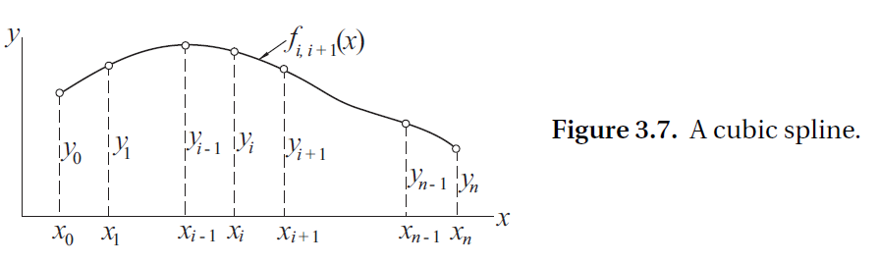
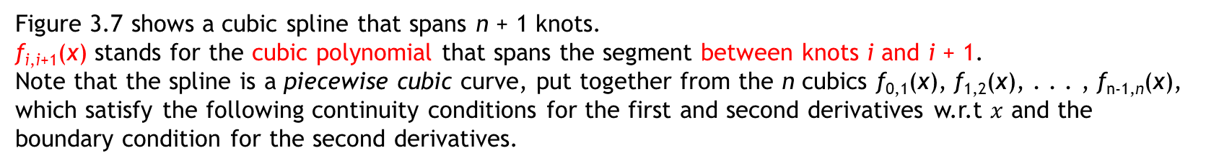
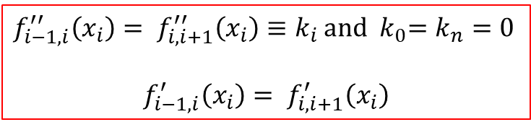
Interpolation with Cubic Spline
If there are more than a few data points, a cubic spline is considerably “stiffer” than a polynomial in the sense that it has less tendency to oscillate between data points.
Figure 3.7 shows a cubic spline that spans n + 1 knots.
f_{i,i+1}(x) stands for the cubic polynomial that spans the segment between knots i and i + 1.
Note that the spline is a piecewise cubic curve, put together from the n cubics f_{0,1}(x), f_{1,2}(x), . . . , f_{n-1,n}(x), which satisfy the following continuity conditions for the first and second derivatives w.r.t $x$ and the boundary condition for the second derivatives.
$f_{i−1,i}^{′′}\left(x_{i}\right)= f_{i,i+1}^{′′}\left(x_{i}\right)≡k_{i}$ and ${ k}_{0}=k_{n}=0$
$$f_{i−1,i}^{′}\left(x_{i}\right)= f_{i,i+1}^{′}\left(x_{i}\right)$$

Slide 27
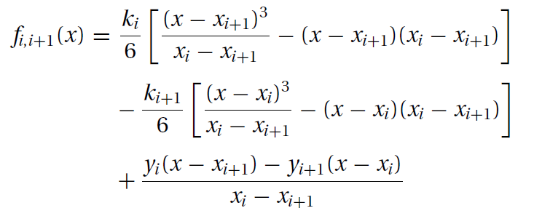
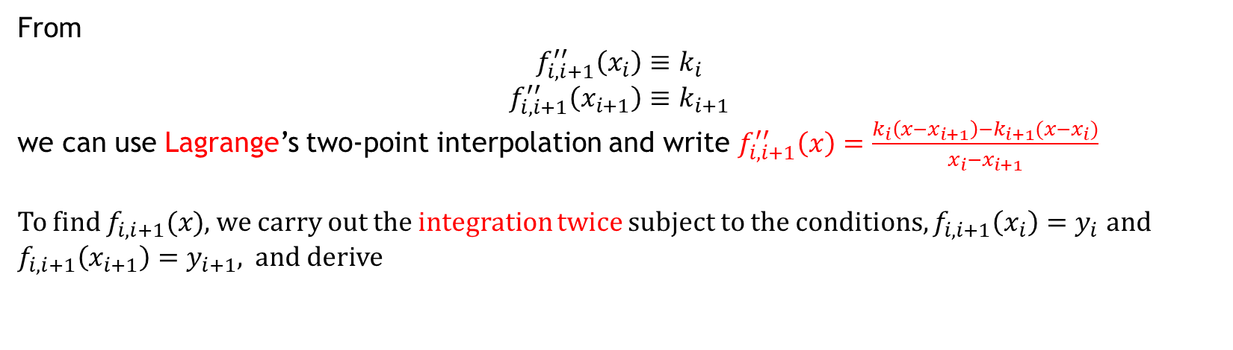
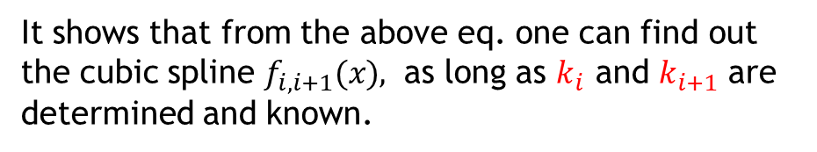
Interpolation with Cubic Spline
From
$$f_{i,i+1}^{′′}\left(x_{i}\right)≡k_{i}$$
$$f_{i,i+1}^{′′}\left(x_{i+1}\right)≡k_{i+1}$$
we can use Lagrange’s two-point interpolation and write $f_{i,i+1}^{′′}\left(x\right)=\frac{k_{i}\left(x−x_{i+1}\right)−k_{i+1}(x−x_{i})}{x_{i}−x_{i+1}}$
To find $f_{i,i+1}(x)$, we carry out the integration twice subject to the conditions, $f_{i,i+1}\left(x_{i}\right)=y_{i}$ and $f_{i,i+1}\left(x_{i+1}\right)=y_{i+1}$, and derive
It shows that from the above eq. one can find out the cubic spline $f_{i,i+1}(x)$, as long as $k_{i}$ and $k_{i+1}$ are determined and known.

Slide 28
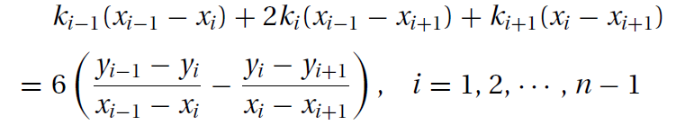
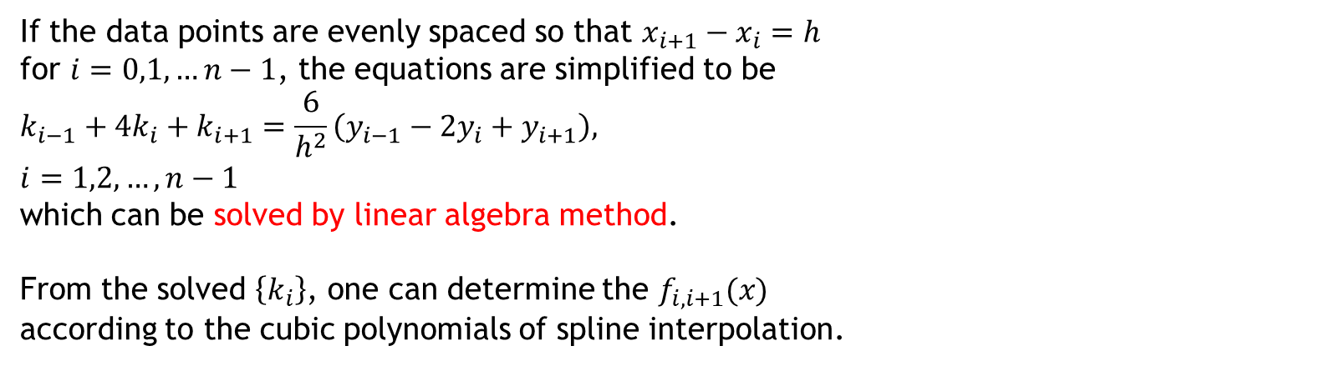
Interpolation with Cubic Spline
From the slope continuity condition $f_{i−1,i}^{′}\left(x_{i}\right)= f_{i,i+1}^{′}\left(x_{i}\right)$ and $k_{0}=k_{n}=0$, $\left\{k_{i}\right\}$ are shown to satisfy the following coupled equations
If the data points are evenly spaced so that $x_{i+1}−x_{i}=h$
for $i=0,1,…n−1$, the equations are simplified to be
$$k_{i−1}+4k_{i}+k_{i+1}=\frac{6}{h^{2}}\left(y_{i−1}−2y_{i}+y_{i+1}\right),$$
$$i=1,2,…,n−1$$
which can be solved by linear algebra method.
From the solved $\left\{k_{i}\right\}$, one can determine the $f_{i,i+1}(x)$
according to the cubic polynomials of spline interpolation.

